Slide 1
The Other Side of Canvas
An instructor's point of view

Slide 2
THREE KEY AREAS
Communication
Inbox
Announcements
Notification
Organization
Modules
Pages
Files
Assessments
Assignments
Quizzes/Exams
Grades/SpeedGrader
Notes:
KEY POINTS
Building community in online course is just as important (if not more so) than in a face-to-face course
Instructors should make their presence known and felt by students.
Asynchronous courses require creativity and a little more effort to to make presence known
Students should also make their presence known and felt to the instructors
Students will need opportunities to interact with each other - if the instructor is not available, perhaps they can learn from each other if they know that other students are listening
Instructors need to reach out and help students stay on track with their learning goals and outcomes

Slide 3
Communication
Center For Advancing Faculty Excellence

Slide 4
Why is communication important?
Instructor presence
In an online course, how will students know they are being heard and listened to?
Student presence
In an online course, how will you know if students are listening to you?
Student-student interactions
Students can learn from each other
Instructor-student interactions
Instructors help students stay on track with their learning process
Notes:
KEY POINTS
Building community in online course is just as important (if not more so) than in a face-to-face course
Instructors should make their presence known and felt by students.
Asynchronous courses require creativity and a little more effort to to make presence known
Students should also make their presence known and felt to the instructors
Students will need opportunities to interact with each other - if the instructor is not available, perhaps they can learn from each other if they know that other students are listening
Instructors need to reach out and help students stay on track with their learning goals and outcomes

Slide 5
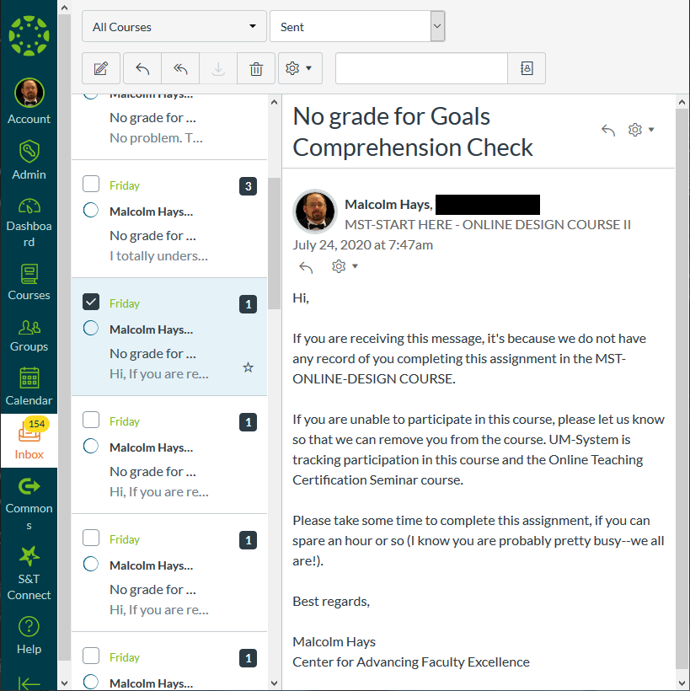
Communication - Inbox
Inbox
Internal mail system within Canvas
Sends emails to students’ & instructors’ external email account (Gmail/Outlook/etc.)
Great for managing conversations within a course
Notes:
KEY POINTS
Canvas has its own internal email system that can work with students’/instructors’ existing email accounts to provide constant updates from the course.
Instructors and students can use the Inbox in Canvas to track conversations
Alternatively, set up email filtering rules for your courses so that emails don’t get lost. Encourage students to do the same!

Slide 6
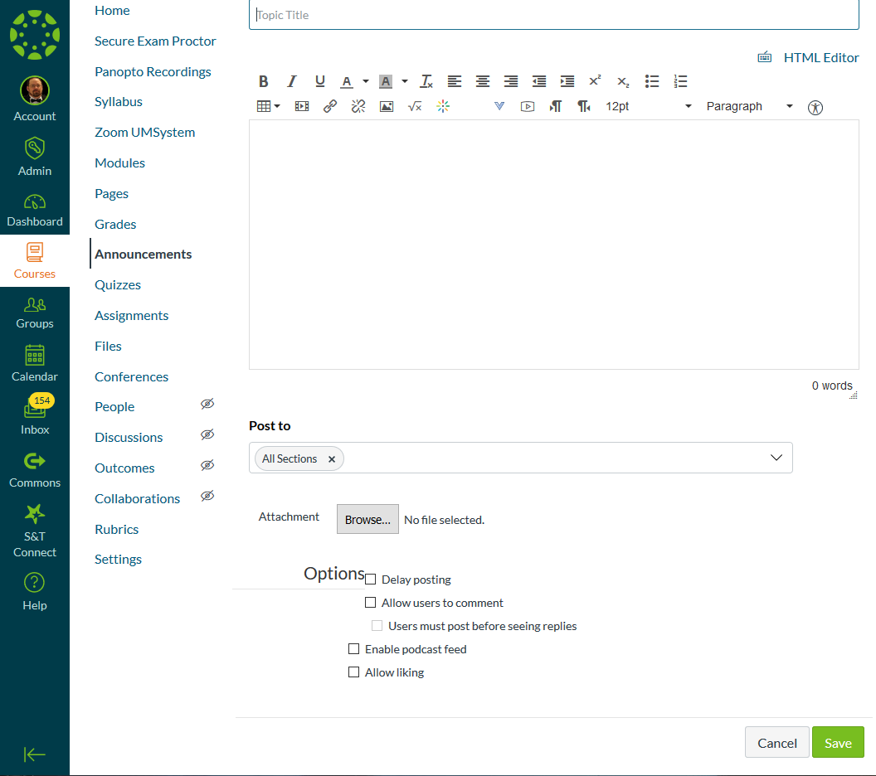
Communication - Announcements
Announcements
Mostly one-way communication channel
May be differentiated based on Sections
May be delayed for future release
Notes:
KEY POINTS:
Announcements is a “broadcasting” communication service - wide distribution, mostly one way.
Announcements can be differentiated by section so that different sections can receive different announcements
Example - Section 101 has a test at 10 a.m. and Section 102 has a test at 11 a.m., so send out reminders for each section.
Announcements can be set up for a delayed release schedule.
Write most of your announcements ahead of time and then set the dates/times of the release (e.g. exam schedule)
Announcements allow attachments to be added
Example - study guides for exams or updated syllabus

Slide 7
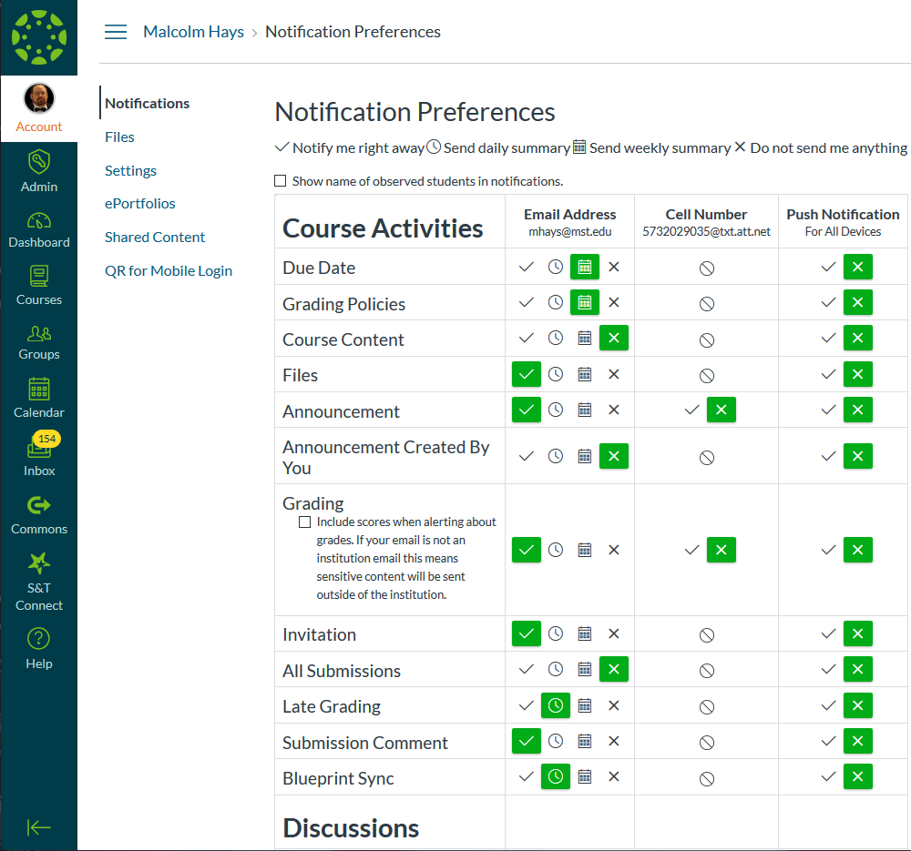
Communication - Notifications (account)
Notifications
Personalized for each user
Managed at two-levels
Account level
Course level
Notes:
KEY POINTS:
Notifications are personalized by user - each user can custom define notifications based on their own preferences
Two layers of notifications: Account level and Course level
Account level notifications apply to ALL courses in which you are enrolled
Course level notifications only apply to the course in which they are configured

Slide 8
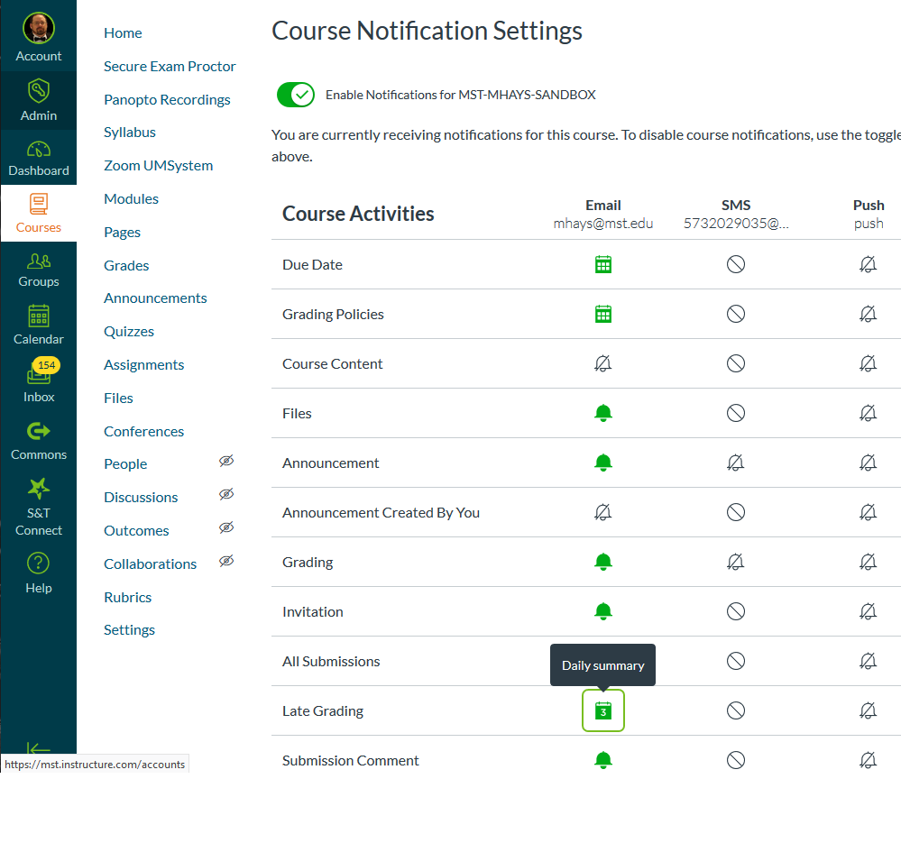
Communication - Notifications (course)
Notifications
Personalized for each user
Managed at two-levels
Account level
Course level
Notes:
KEY POINTS:
Notifications are personalized by user - each user can custom define notifications based on their own preferences
Two layers of notifications: Account level and Course level
Account level notifications apply to ALL courses in which you are enrolled
Course level notifications only apply to the course in which they are configured

Slide 9
Organization
Center For Advancing Faculty Excellence

Slide 10
Why is organization important?
Logical progression of materials for students
Easy to find resources
Motivate student engagement
Keep students focused and moving forward
Minimize distractions for students
Reduction of cognitive load
Teachers are designers. An essential act of our profession is the design of curriculum and learning experiences to meet specified purposes.
-- Wiggins and McTighe, Understanding by Design (2005)

Slide 11
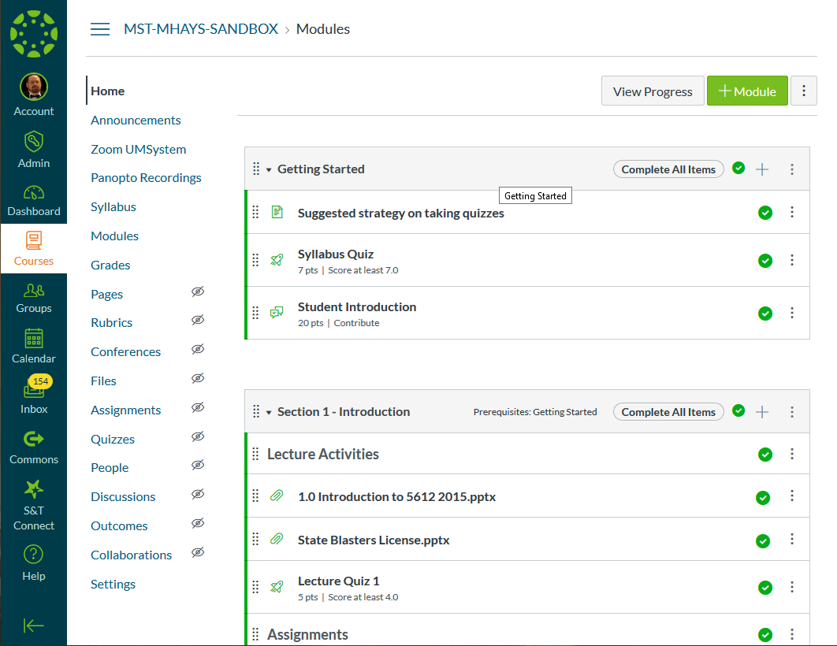
Organization - Modules
Modules
Simple, yet efficient
Link to other content in Canvas (Pages, Quizzes, Quizzes, Panopto Recordings, etc.)
Guided progression through course
Notes:
KEY POINTS:
Modules are a quick and easy way to organize your content
Modules just link to already existing content in an organized way
Guide students through your course in a manner that makes sense to THEM (student-centered)
CAFE has a template available to help organize your modules and files
Add prerequisites and thresholds to manage student progress

Slide 12
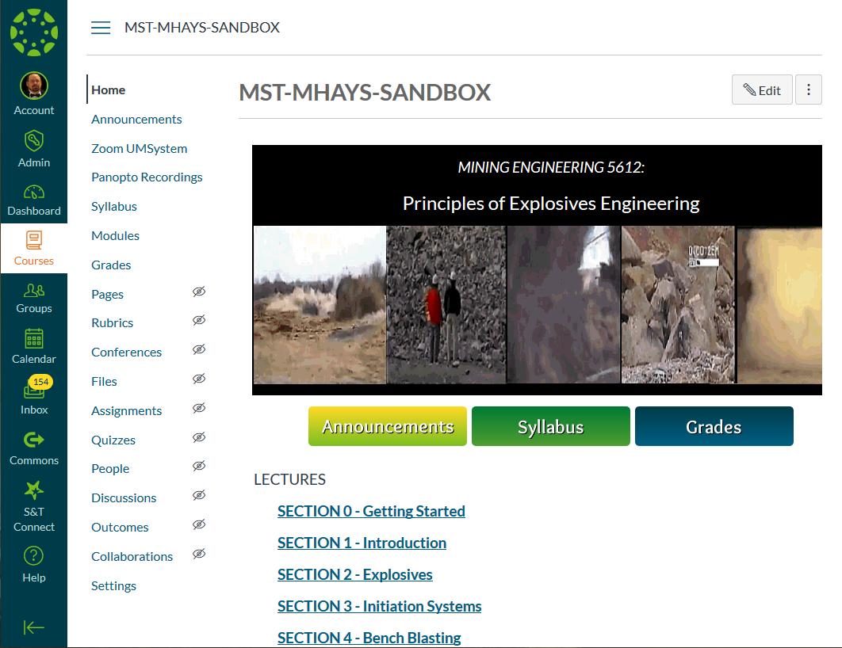
Organization - Pages
Pages
Lots of flexibility for content
Much more engaging visually
More time & effort to create than modules
Notes:
KEY POINTS:
Like Modules, Pages can be used to organize content.
Requires more time and effort to create than Modules, but is visually more pleasing and offers more opportunities for creative navigation
Splashy Home page is engaging for students and helps set tone for the course.

Slide 13
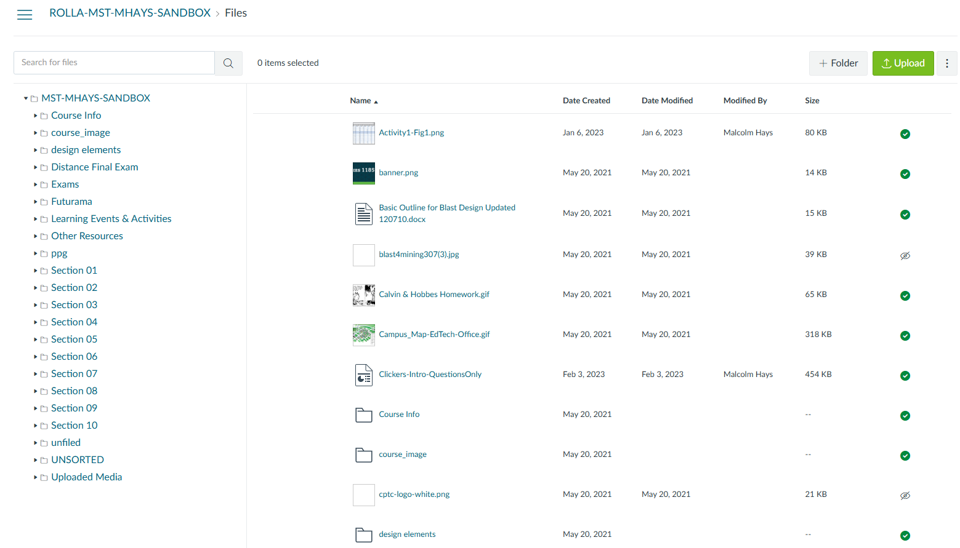
Organization - Files
Files
RECOMMENDED:
Hide FILES from students
Link to FILES from MODULES
Organize files into folders
Notes:
KEY POINTS:
Hiding the Files section from students prevents them from directly accessing the content
Link to the Files from Modules or Pages
If Files will be your primary organizational tool, organize Files into Folders that make logical sense FOR STUDENTS! (Student centered)

Slide 14
Organization – Course Menu
Course Menu Navigation
REMOVE/HIDE what isn’t being used
ADD/KEEP what is being used
Notes:
KEY POINTS:
Like Modules, Pages can be used to organize content.
Requires more time and effort to create than Modules, but is visually more pleasing and offers more opportunities for creative navigation
Splashy Home page is engaging for students and helps set tone for the course.

Slide 15
Asessesments
Center For Advancing Faculty Excellence

Slide 16
Why assess students?
What are you measuring/evaluating? Why?
Are your assessments formative? Or summative?
How many assessments are enough?
What will students learn about themselves through your assessments?
Do your assessments measure your student learning outcomes?
“Evaluation without development is punitive. Development without evaluation is guesswork.”
Theall, M. (2007, June 11). Basic issues in good evaluation practice. Invited presentation at the Academic Impressions Institute’s Using Faculty Evaluation Data for Decision Making, Boston, MA.

Slide 17
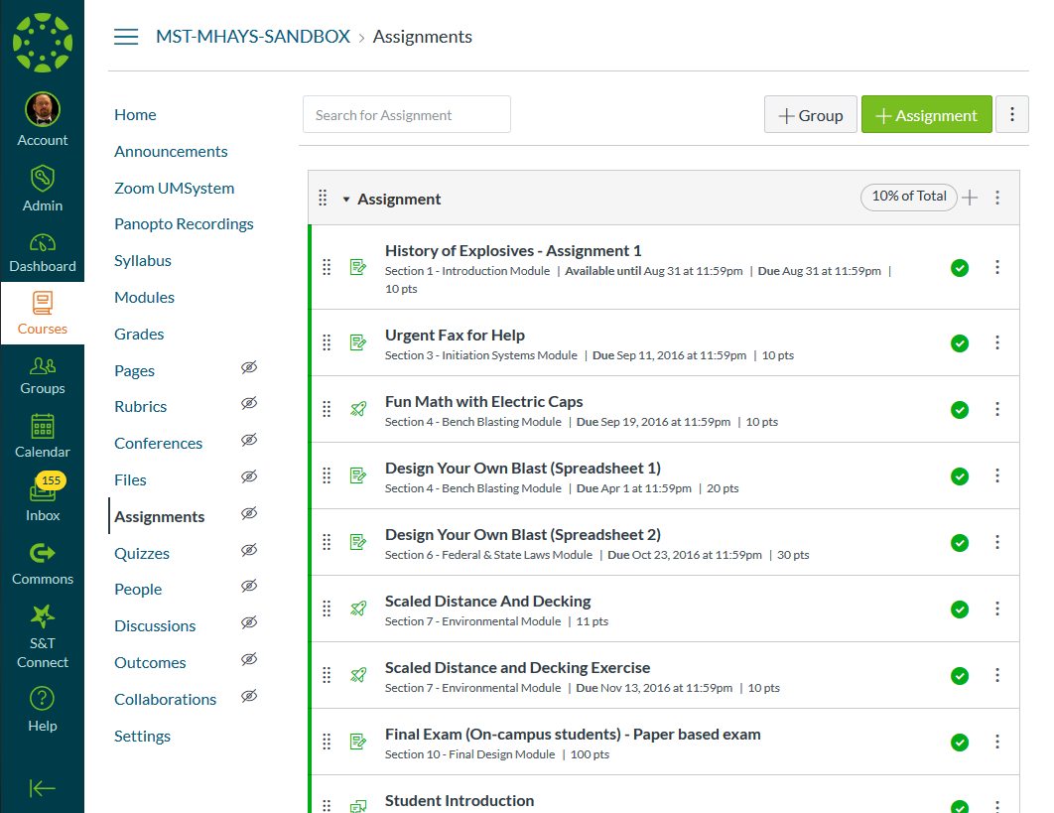
Assignments
Variety of submission types
Similarity-checking options
Allow for peer-review
Can be assigned to groups
Allow for weighted grading
Notes:
KEY POINTS:
There are several different options for student submissions:
No Submission - creates blank column in the Gradebook
Online - Allows for text entry, website URLs, Media Recordings, and File uploads
On Paper - students hand in paper physically, creates blank column in Gradebook
External Tool - third-party applications from publishers, such as Pearson, McGraw-Hill, Cengage, etc.
Similarity (“Plagiarism”) Checking - Turnitin software checks against BILLIONS of papers to find matches.
Use it to help students cite sources correctly.
Peer-review - students are randomly assigned other students’ work to evaluate against a rubric and provide feedback.
Weighted grading - Set up Assignment Groups so that different categories of assignments are weighted properly
EXAMPLES - Labs, Homework, Exams, Discussions, Participation, Clicker Points, etc.

Slide 18
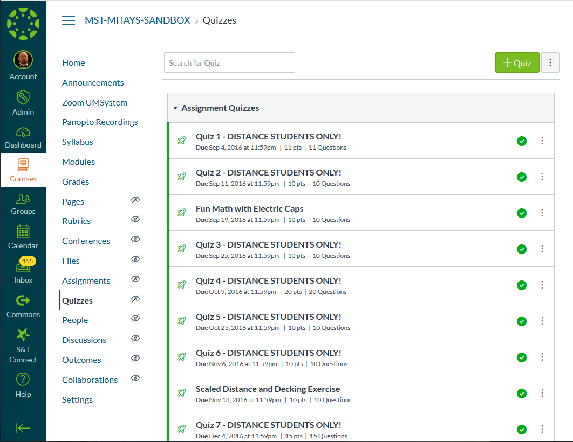
Quizzes / Exams / Tests
LOTS of question types!
Randomization options
Shuffle answers
Question banks
Feedback options
Quiz Analytics
Moderate Quizzes for different student needs
Students with disabilities
Notes:
KEY POINTS:
First, set up Quiz/Exam container with Quiz parameters
Second, create Questions
Question Types include:
Multiple Choice
Fill-in-Multiple Blanks
Matching
Numerical Answer
Formula
Essay
File Upload
And more…
Randomization through mixing up responses and question banks mitigates cheating attempts
Feedback options to help students use the Quizzes as a learning tool.
Quiz analytics gives detailed breakdown of how well students performed on Quizzes
Moderate Quizzes gives options for additional time or attempts - great for students with a documented disability!

Slide 19
Surveys
Graded or Ungraded
Anonymous responses
Same options as Quizzes
Notes:
KEY POINTS:
Surveys are created with the same tool as Quizzes.
Graded surveys only record if a student has completed the survey or not.
Responses are anonymous.

Slide 20
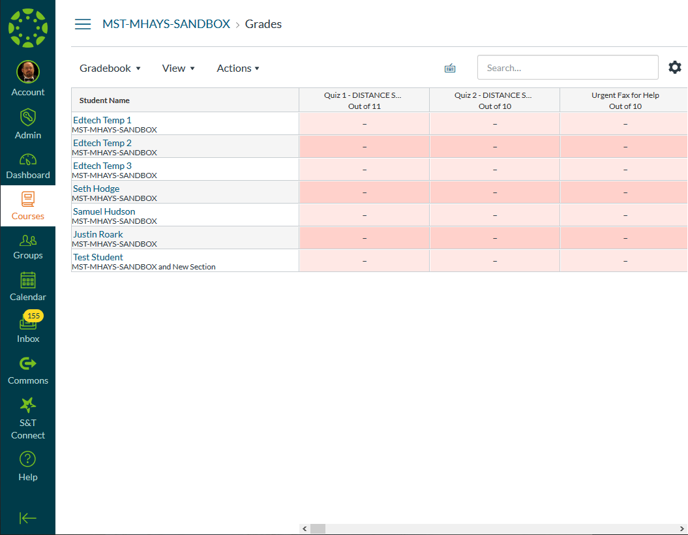
Grades
ALL columns must be set up as Assignment!
Late grade policies
Grade History for each student
Export grades into Joe’SS
Message student(s) who...
Notes:
KEY POINTS:
EVERYTHING that is graded in Canvas MUST be created as an assessment (Assignment, Quiz, or Discussion)
Gradebook allows for custom late grading policies
Entire Grade History is tracked for each student and every assignment
Grades can be exported from Canvas to Joe’SS for mid-semester and final grades.
“Message students who” is a great function for communicating with specific subgroups of students
View Grades based on section or other filters

Slide 21
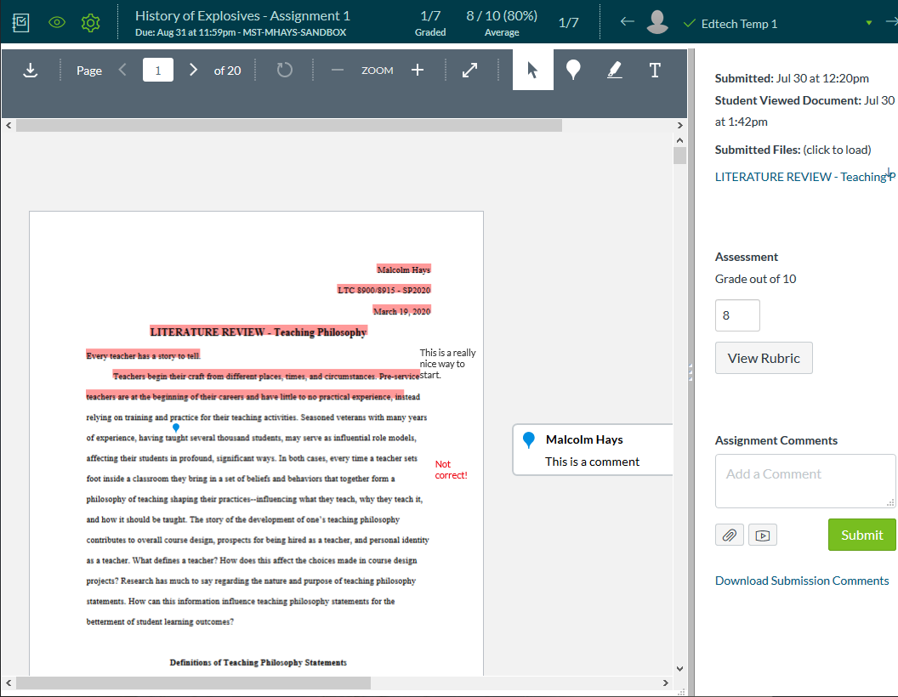
SpeedGrader
Quickly grade student submissions
Annotate PDF/DOCX/PPT/etc.
Provide detailed feedback
Grade Assignments, Quizzes, Discussions
Notes:
KEY POINTS:
Built-in annotation tools to grade assignments
Downloading annotated PDF can sometimes be tricky--depends on your PDF-reading/editing software. Adobe PDF Reader is FREE and seems to work best.
SpeedGrader works for Assignments, Quizzes, and Discussions
Assignments is limited by type of file uploaded. Works best with Office docs or otherwise “standard” file types such as PDF
Discussions shows ALL of the student’s contributions to a discussion thread in one handy place.
Quizzes shows ALL of student’s responses -- manually-graded questions such as Essay or Short-Answer can be graded here.
Use the Feedback options to provide detailed commentary on students’ work.
Ask students to respond to comments!

Slide 22
Canvas Course Request System
Center For Advancing Faculty Excellence

Slide 23
What is the Canvas Request System?
Managed by UM-System Office of eLearning
Available at: canvasrequest.umsystem.edu
Course Combo - combine sections of courses
Course User Assignment - add users to non-Registrar courses
New Course - request a “DEV” shell (empty course)
Course Copy - request a course copy for courses in which you are NOT the instructor
Delayed Grade Sections - Used for “Incompletes”
Test Student Accounts - Does not apply to S&T
Notes:
KEY POINTS:
EVERYTHING that is graded in Canvas MUST be created as an assessment (Assignment, Quiz, or Discussion)
Gradebook allows for custom late grading policies
Entire Grade History is tracked for each student and every assignment
Grades can be exported from Canvas to Joe’SS for mid-semester and final grades.
“Message students who” is a great function for communicating with specific subgroups of students
View Grades based on section or other filters

Slide 24
Title II Digital Accessiblity
Center For Advancing Faculty Excellence

Slide 25
Title II Digital Accessibility – What is it?
ADA Title II requires state and local governments to make digital content accessible for people with disabilities.
Applies to websites, mobile and desktop applications, online forms, documents and videos.
Must follow WCAG 2.1 Level AA standards by April 2026.

Slide 26
What Does It Include?
Text, images, forms, and videos must be usable with screen readers and keyboard navigation.
Images need alternative text ("alt text").
Videos need captions.
Text must be readable and high-contrast.
Covers all digital services, including third-party tools and mobile apps.

Slide 27
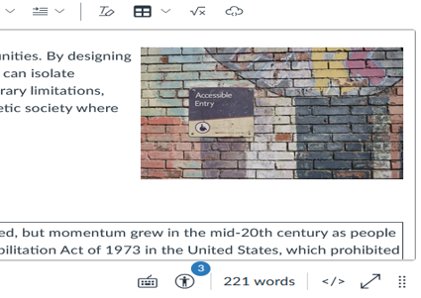
Canvas Accessibility Checker
Canvas accessibility checker will check the page you have opened
To access the checker select the page you would like to review and click edit
The number above the icon shows the accessibility issues the checker found

Slide 28
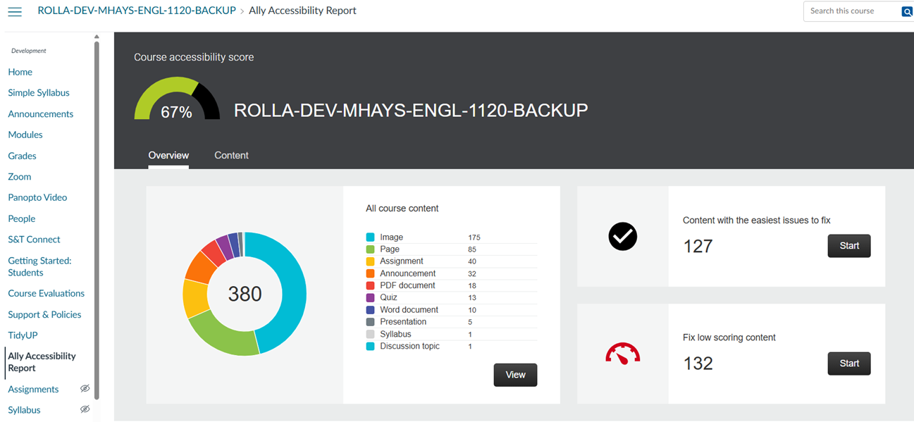
Blackboard Ally in Canvas
Canvas accessibility checker will check the page you have opened
To access the checker select the page you would like to review and click edit
The number above the icon shows the accessibility issues the checker found

Slide 29
Digital Accessibility Resources
Student Accessibility and Testing:
saat@mst.edu
573-341-6655
G-10 Norwood Hall
Digital Access Website:
Digital Accessibility is a Requirement

Slide 30
Need Help?
Google search for “Canvas Instructor Guides”
IT Help Desk
573-341-HELP or help.mst.edu
Missouri Online
teachingtools@umsystem.edu / canvas@umsystem.edu / 855-675-0755
Center for Advancing Faculty Excellence
cafe@mst.edu / cafe.mst.edu / 573-341-6713
Notes:
KEY POINT:
Please remember to publish your course!
#1 complaint from students on first day of class - “I can’t see my course!”

Slide 31
Questions?
Center for Advancing Faculty Excellence
WEB: cafe.mst.edu
EMAIL: cafe@mst.edu
PHONE: 573-341-6713
Digital Accessibility is a Requirement

